Slide 1
MLOps
Anshu Pandey

Slide 2
Deploying Model using mlflow

Slide 3
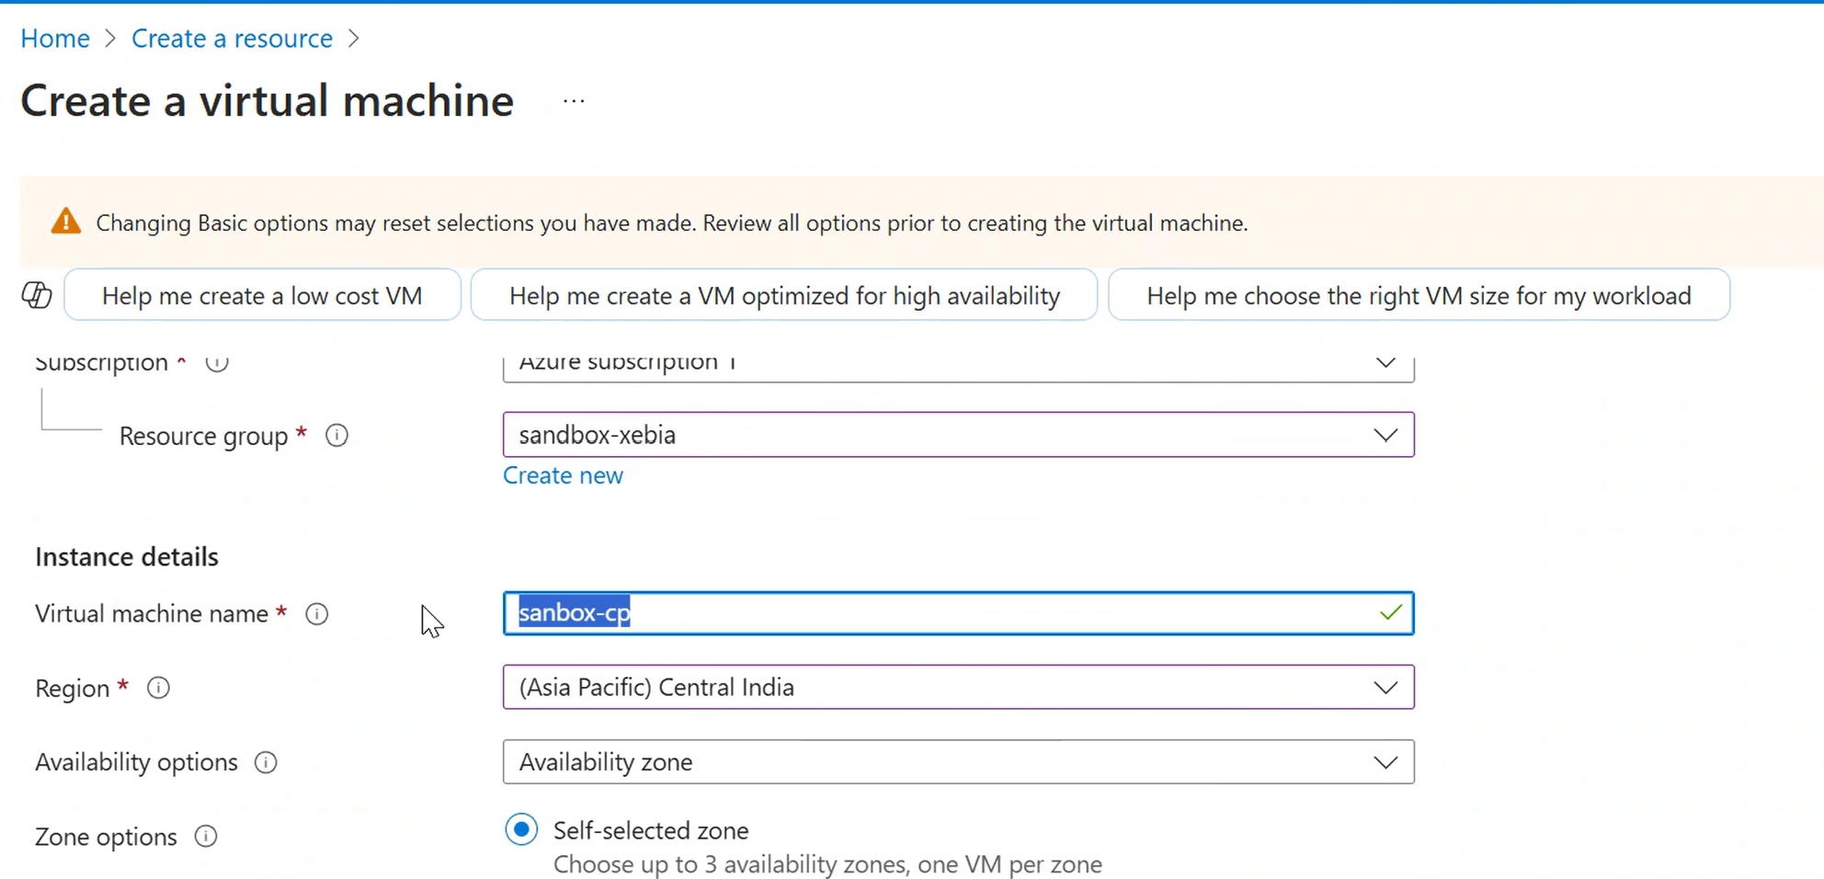
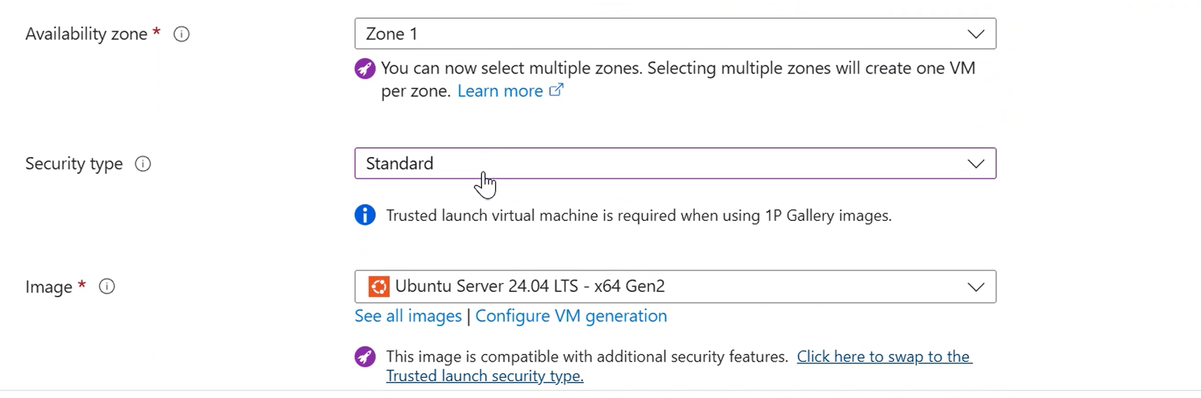
Deploying model over azure VM
Setup an azure VM with following details

Slide 4
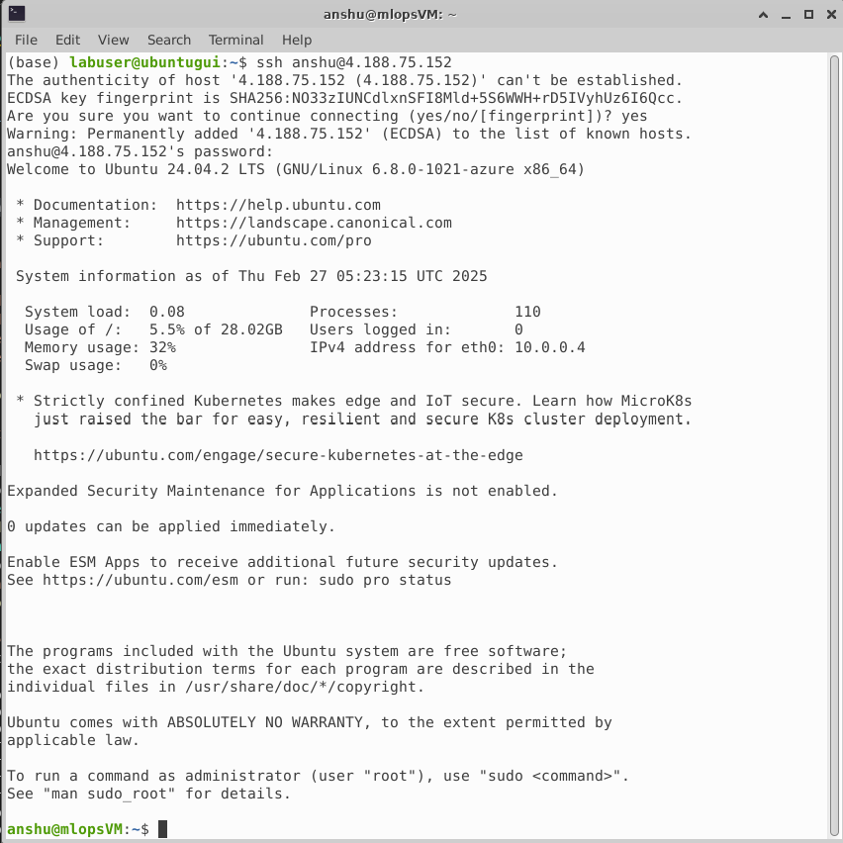
Step 1: Setup the VM -Connect to VM via SSH
ssh <username>@<ip>
E.g. ssh anshu@4.188.75.152
Enter password if asked

Slide 5
Step 1: Setup the VM – setup VM
sudo apt update
sudo apt upgrade
sudo apt install python3 python3-pip python3-venv -y
## create an environment and set it up
python3 -m venv myenv
source myenv/bin/activate
pip install pandas scikit-learn mlflow matplotlib flask psutil

Slide 6
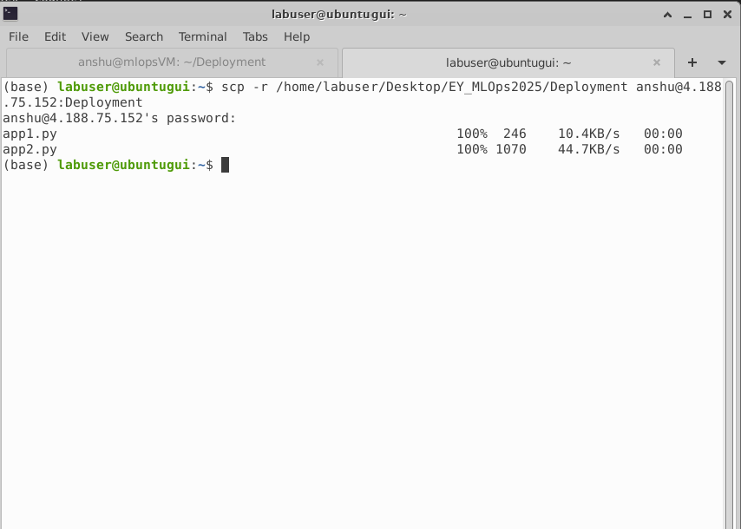
Step 2: Copy Files
scp -r /path/to/local/folder username@remote_host:/path/to/remote/directory/

Slide 7
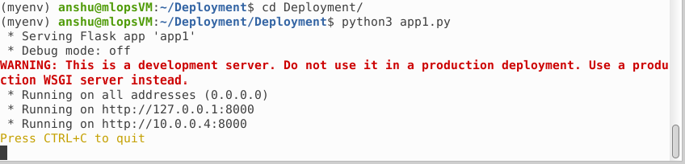
Step 3: Run the app
python3 app1.py

Slide 8
from flask import Flask, request
import pandas as pd
import mlflow, mlflow.sklearn, mlflow.artifacts
import json, subprocess
mlflow.set_tracking_uri(uri="http://4.188.75.152:5000/")
app = Flask(__name__)
model_name="CPM001"
alias = 'stagging’
mlflow.artifacts.download_artifacts(artifact_uri=f"models:/{model_name}@{alias}/requirements.txt",dst_path="./")
subprocess.run(['pip','install', '-r', 'requirements.txt'])
model = mlflow.pyfunc.load_model(f"models:/{model_name}@{alias}")
@app.route("/get_schema")
def func1():
schema = {'encoder__Geography_Germany': "double (required)", 'encoder__Geography_Spain': "double (required)",
'encoder__Gender_Male': "double (required)", 'scaler__CreditScore': "double (required)",
'scaler__Age': "double (required)", 'scaler__Balance': "double (required)",
'scaler__NumOfProducts': "double (required)", 'remainder__IsActiveMember': "double (required)"}
return json.dumps(schema)
@app.route("/predict", methods=['GET','POST'])
def func2():
data = request.data
data = data.decode()
data = json.loads(data)
df = pd.DataFrame(data)
output = model.predict(df)
data['prediction'] = str(output[0])
return json.dumps(data)
if __name__=="__main__":
app.run(debug=False,port=8000,host="0.0.0.0")

Slide 9
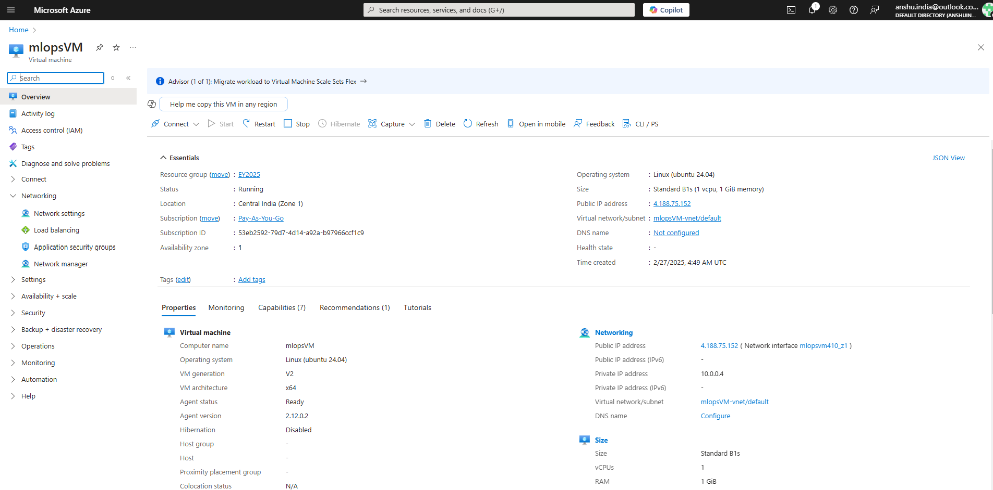

Slide 10
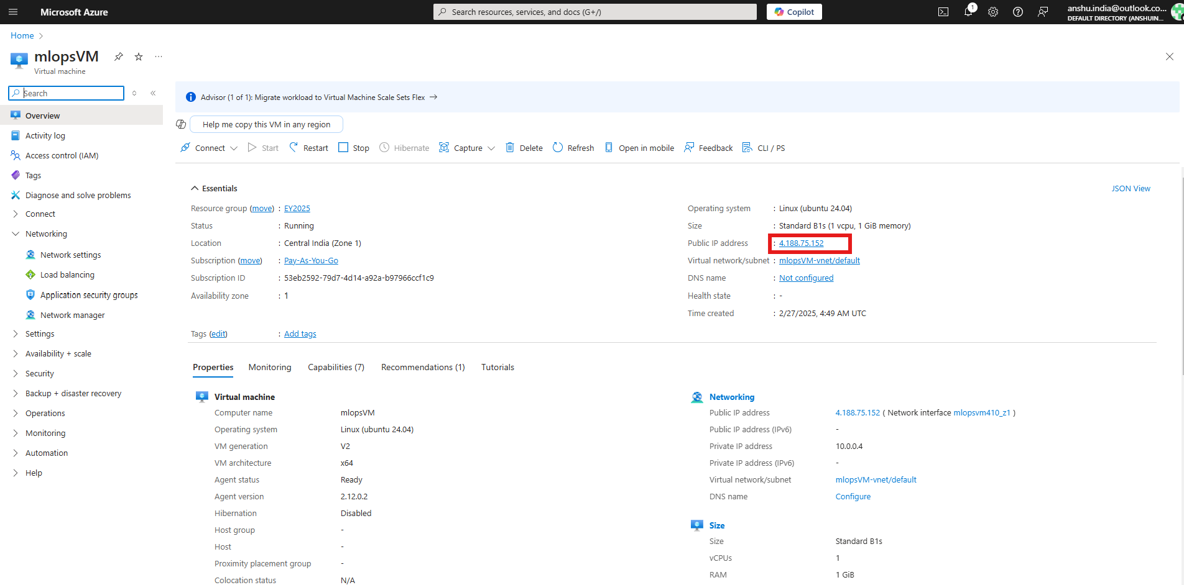

Slide 11
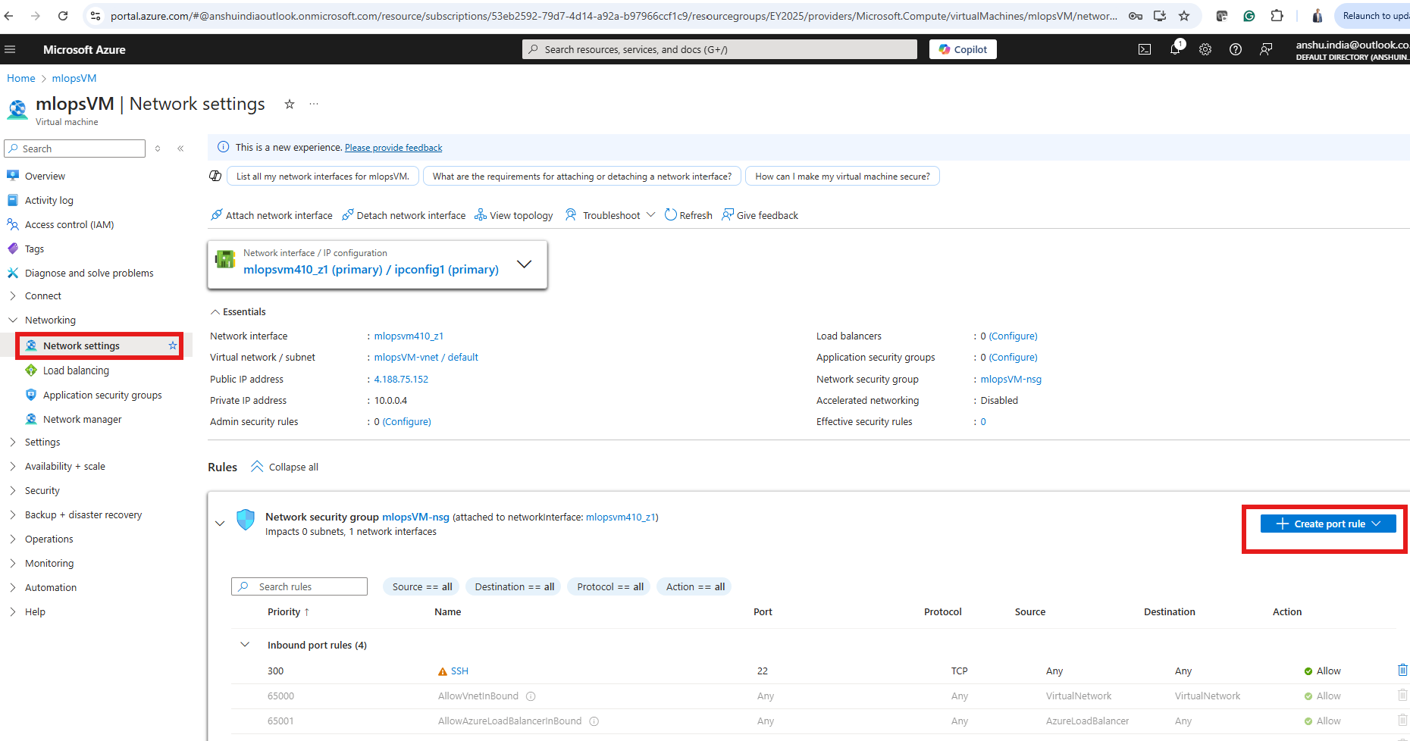

Slide 12
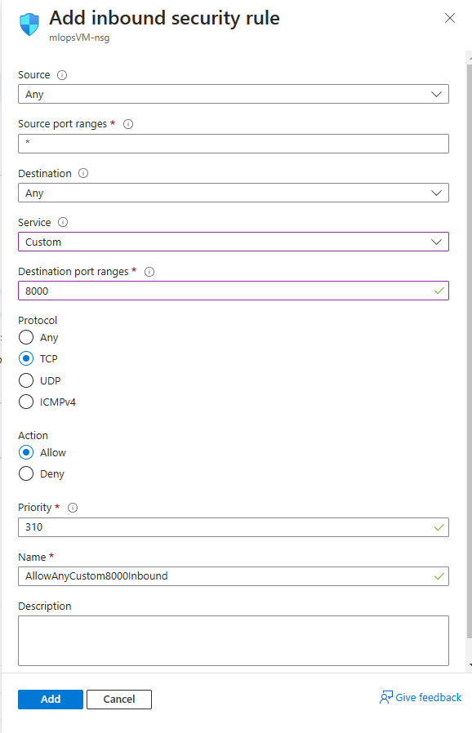

Slide 13
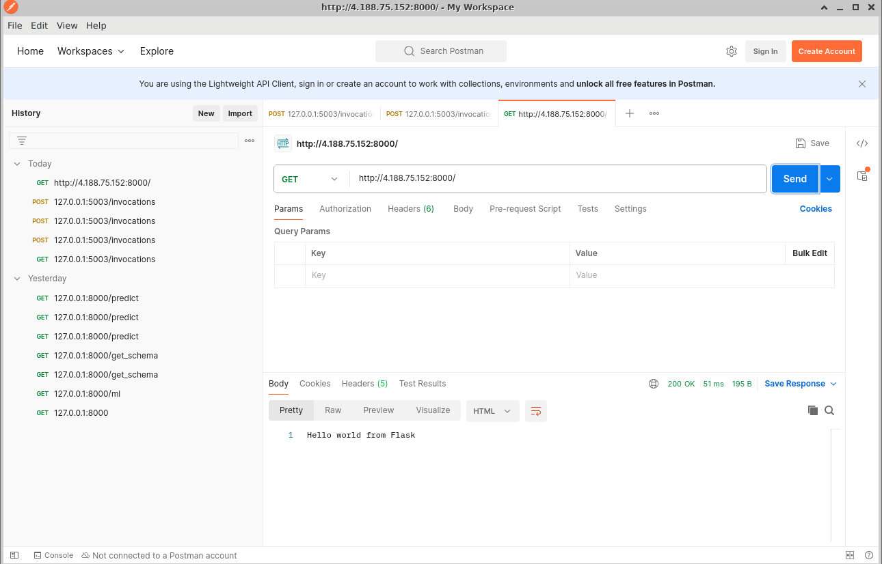

Slide 15
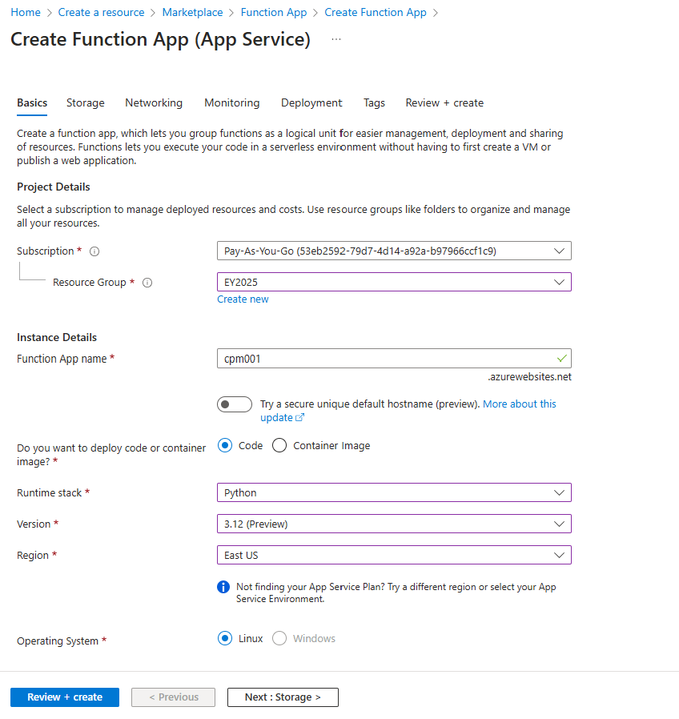
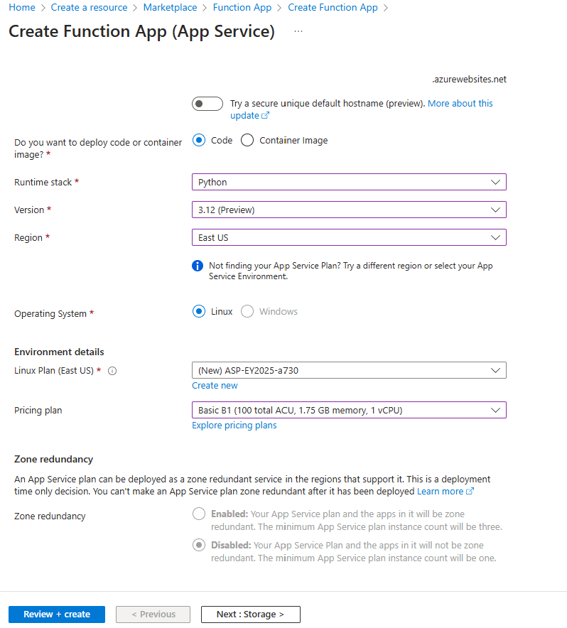

Slide 16

CICD Pipeline with GitHub Actions <-> Azure ML

Slide 17
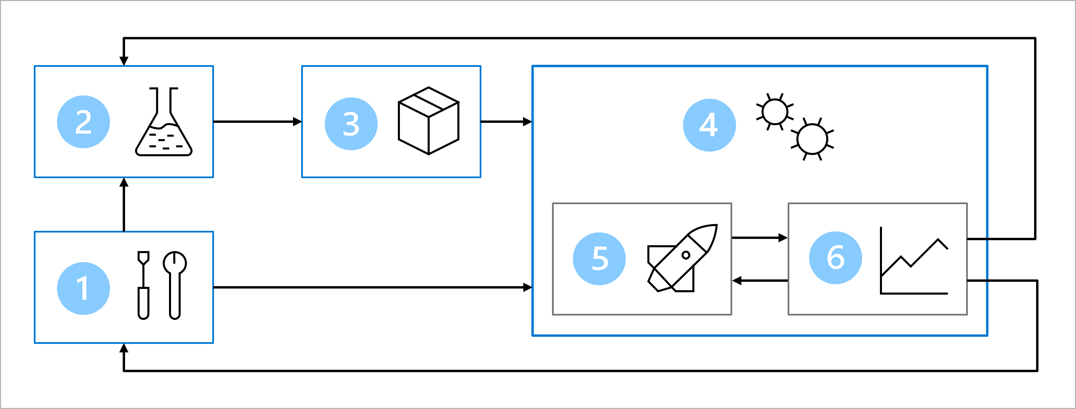
MLOps Architecture
Setup: Create all necessary Azure resources for the solution.
Model development (inner loop): Explore and process the data to train and evaluate the model.
Continuous integration: Package and register the model.
Model deployment (outer loop): Deploy the model.
Continuous deployment: Test the model and promote to production environment.
Monitoring: Monitor model and endpoint performance.

Slide 18
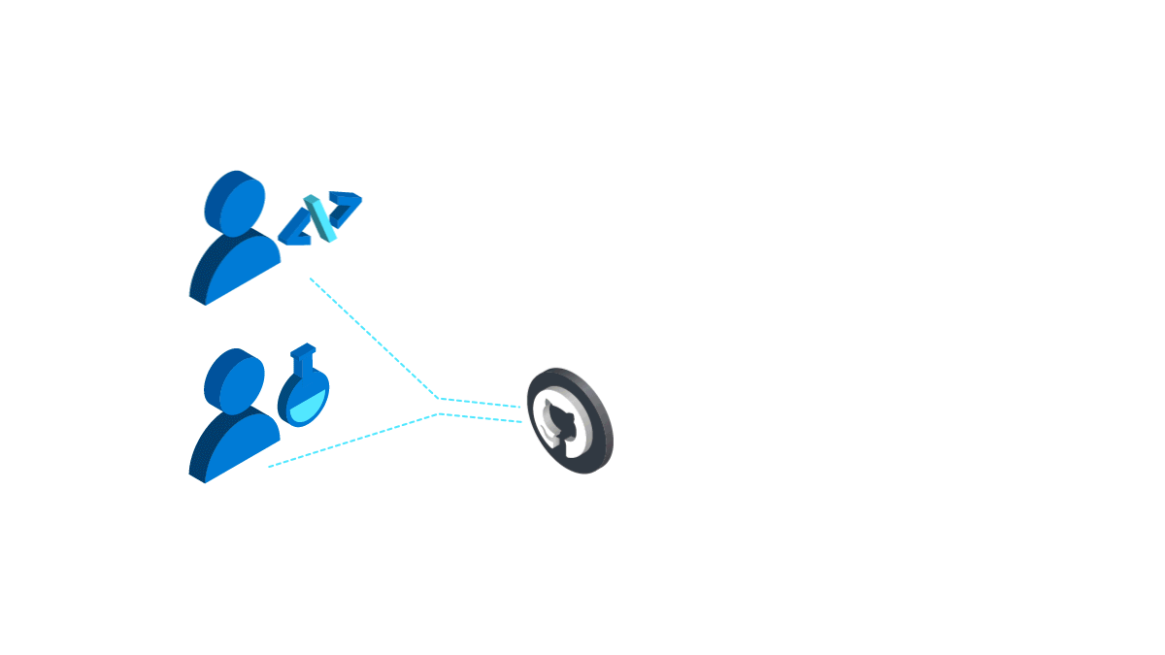
MLOPs with Azure & GitHub Actions

Slide 19
CI pipeline
Job Execution on Azure Machine Learning
8
7
GItHub Actions Workflow Trigger
A merge to the main branch is equivalent to push to main branch which triggers automated workflow to run a training job in Azure ML
1
Code Repository
(main branch)
6
After the lead data scientist approves the changes, the pull request is merged, and the main branch is updated accordingly.
Pull Request with reports of linting & unit testing
The production code is hosted in the main branch.
5
When the code passes linting and unit testing, the lead data scientist needs to approve the proposed changes.
The data scientist creates a pull request to propose to push changes to the main branch.
3
2
A data scientist creates a feature branch for model development.
Feature/Dev Branch
Pull Request Created
GItHub Actions Workflow Trigger
When a pull request is created, a GitHub Actions workflow is triggered to verify the code.
4

Slide 20
CI Pipeline Milestone 1
Objective:
Setting up GitHub Repository for ML project
Converting notebook to script
Testing local code execution

Slide 21
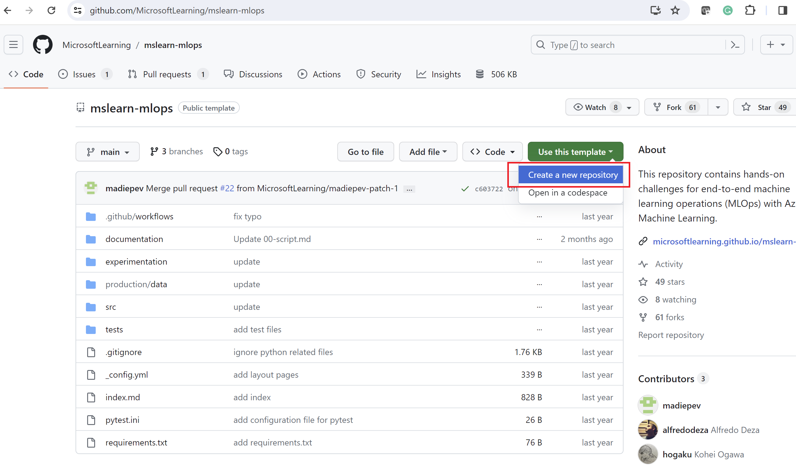
Clone the mlops repo
Create a new public repo by navigating to https://github.com/MicrosoftLearning/mslearn-mlops and selecting the Use this template button to create your own repo.
In the experimentation folder, you’ll find a Jupyter notebook that trains a classification model. The data used by the notebook is in the experimentation/data folder and contains a CSV file.
In the src/model folder you’ll find a train.py script which already includes code converted from part of the notebook. It’s up to you to complete it.

Slide 22
Structure your repo
.cloud: contains cloud-specific code like templates to create an Azure Machine Learning workspace.
.ad/.github: contains Azure DevOps or GitHub artifacts like YAML pipelines to automate workflows.
src: contains any code (Python or R scripts) used for machine learning workloads like preprocessing data or model training.
docs: contains any Markdown files or other documentation used to describe the project.
pipelines: contains Azure Machine Learning pipelines definitions.
tests: contains unit and integration tests used to detect bugs and issues in your code.
notebooks: contains Jupyter notebooks, mostly used for experimentation.

Slide 23
Convert a notebook to a script
Scripts are ideal for testing and automation in your production environment. To create a production-ready script, you'll need to:
Remove nonessential code.
Refactor your code into functions.
Test your script in the terminal.

Slide 24
Remove all nonessential code
The main benefit of using notebooks is being able to quickly explore your data. For example, you can use print() and df.describe() statements to explore your data and variables. When you create a script that will be used for automation, you want to avoid including code written for exploratory purposes.
The first thing you therefore need to do to convert your code to production code is to remove the nonessential code. Especially when you'll run the code regularly, you want to avoid executing anything nonessential to reduce cost and compute time.

Slide 25
Complete the code train.py
The split_data function is already included in the main function. You only need to add the function itself with the required inputs and outputs underneath the comment TO DO: add function to split data.
Add logging so that every time you run the script, all parameters and metrics are tracked. Use the autologging feature of MLflow to also ensure the necessary model files are stored with the job run to easily deploy the model in the future.

Slide 26
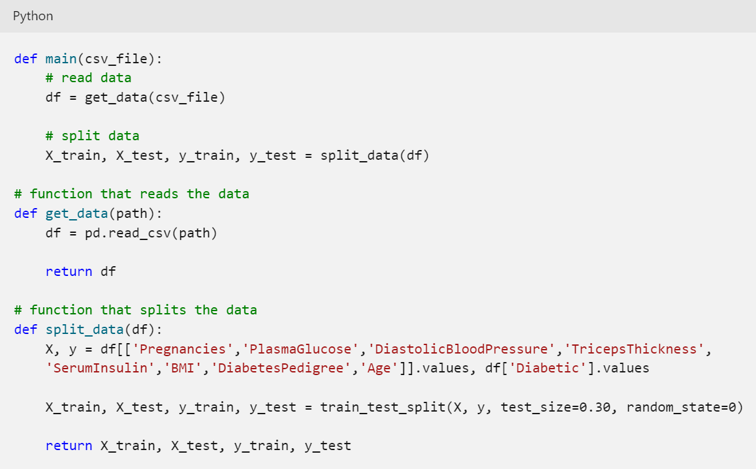
Refactor your code into functions

Slide 27
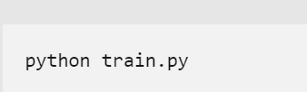
Test your script
Before using scripts in production environments, for example by integrating them with automation pipelines, you'll want to test whether the scripts work as expected.

Slide 28
CI Pipeline Milestone 2
Objective:
Setting up Azure CLI
Setting up Azure ML resources
Testing Azure ML job from Local Machine

Slide 29
Azure CLI
Download: https://learn.microsoft.com/en-us/cli/azure/install-azure-cli-windows?tabs=azure-cli
For linux: curl -sL https://aka.ms/InstallAzureCLIDeb | sudo bash
Setup
az login
az account set -s "<YOUR_SUBSCRIPTION_NAME_OR_ID>“
az extension add -n ml –y
az ml -h

Slide 30
Workspace creation with CLI
az ml workspace create --resource-group scb --name anshu-aml

Slide 31
Workspace creation with CLI
az ml workspace create --resource-group
[--application-insights]
[--container-registry]
[--description]
[--display-name]
[--file]
[--image-build-compute]
[--location]
[--managed-network]
[--name]
[--no-wait]
[--primary-user-assigned-identity]
[--public-network-access]
[--set]
[--tags]
[--update-dependent-resources]

Slide 32
Workspace creation with CLI
az ml workspace create --resource-group
[--application-insights]
[--container-registry]
[--description]
[--display-name]
[--file]
[--image-build-compute]
[--location]
[--managed-network]
[--name]
[--no-wait]
[--primary-user-assigned-identity]
[--public-network-access]
[--set]
[--tags]
[--update-dependent-resources]

Slide 33
Creating compute with CLI
Create a compute cluster, consider creating compute cluster for this lab.
az ml compute create --name aml-compute --size STANDARD_DS11_V2 --max-instances 2 --type AmlCompute --workspace anshu-aml --resource-group scb
Create a compute instance (do not create compute instance for this activity)
az ml compute create --name "testdev-vm" --size STANDARD_DS11_V2 --type ComputeInstance workspace anshu-aml --resource-group scb

Slide 34
Creating environment (optional)
Not needed for this lab az ml environment create --file my_env.yml --resource-group my-resource-group --workspace-name my-workspace
Options: https://learn.microsoft.com/en-us/cli/azure/ml/environment?view=azure-cli-latest#az-ml-environment-create

Slide 35
Create data asset
Use the CLI (v2) to create a registered data asset with the following configuration:
Name: diabetes-dev-folder
Path: The data folder in the experimentation folder which contains the CSV file to train the model. The path should point to the folder, not to the specific file.
az ml data create --name diabetes-dev-folder --version 1 --path "D:\Repos\devb\SCBmlops\experimentation\data" --resource-group scb --workspace-name anshu-aml

Slide 36
Create data asset
az ml data create --name my-data --version 1 --path ./my-data.csv --resource-group my-resource-group --workspace-name my-workspace
az ml data create [--datastore]
[--description]
[--file]
[--name]
[--no-wait]
[--path]
[--registry-name]
[--resource-group]
[--set]
[--skip-validation]
[--type {mltable, uri_file, uri_folder}]
[--version]
[--workspace-name]

Slide 37
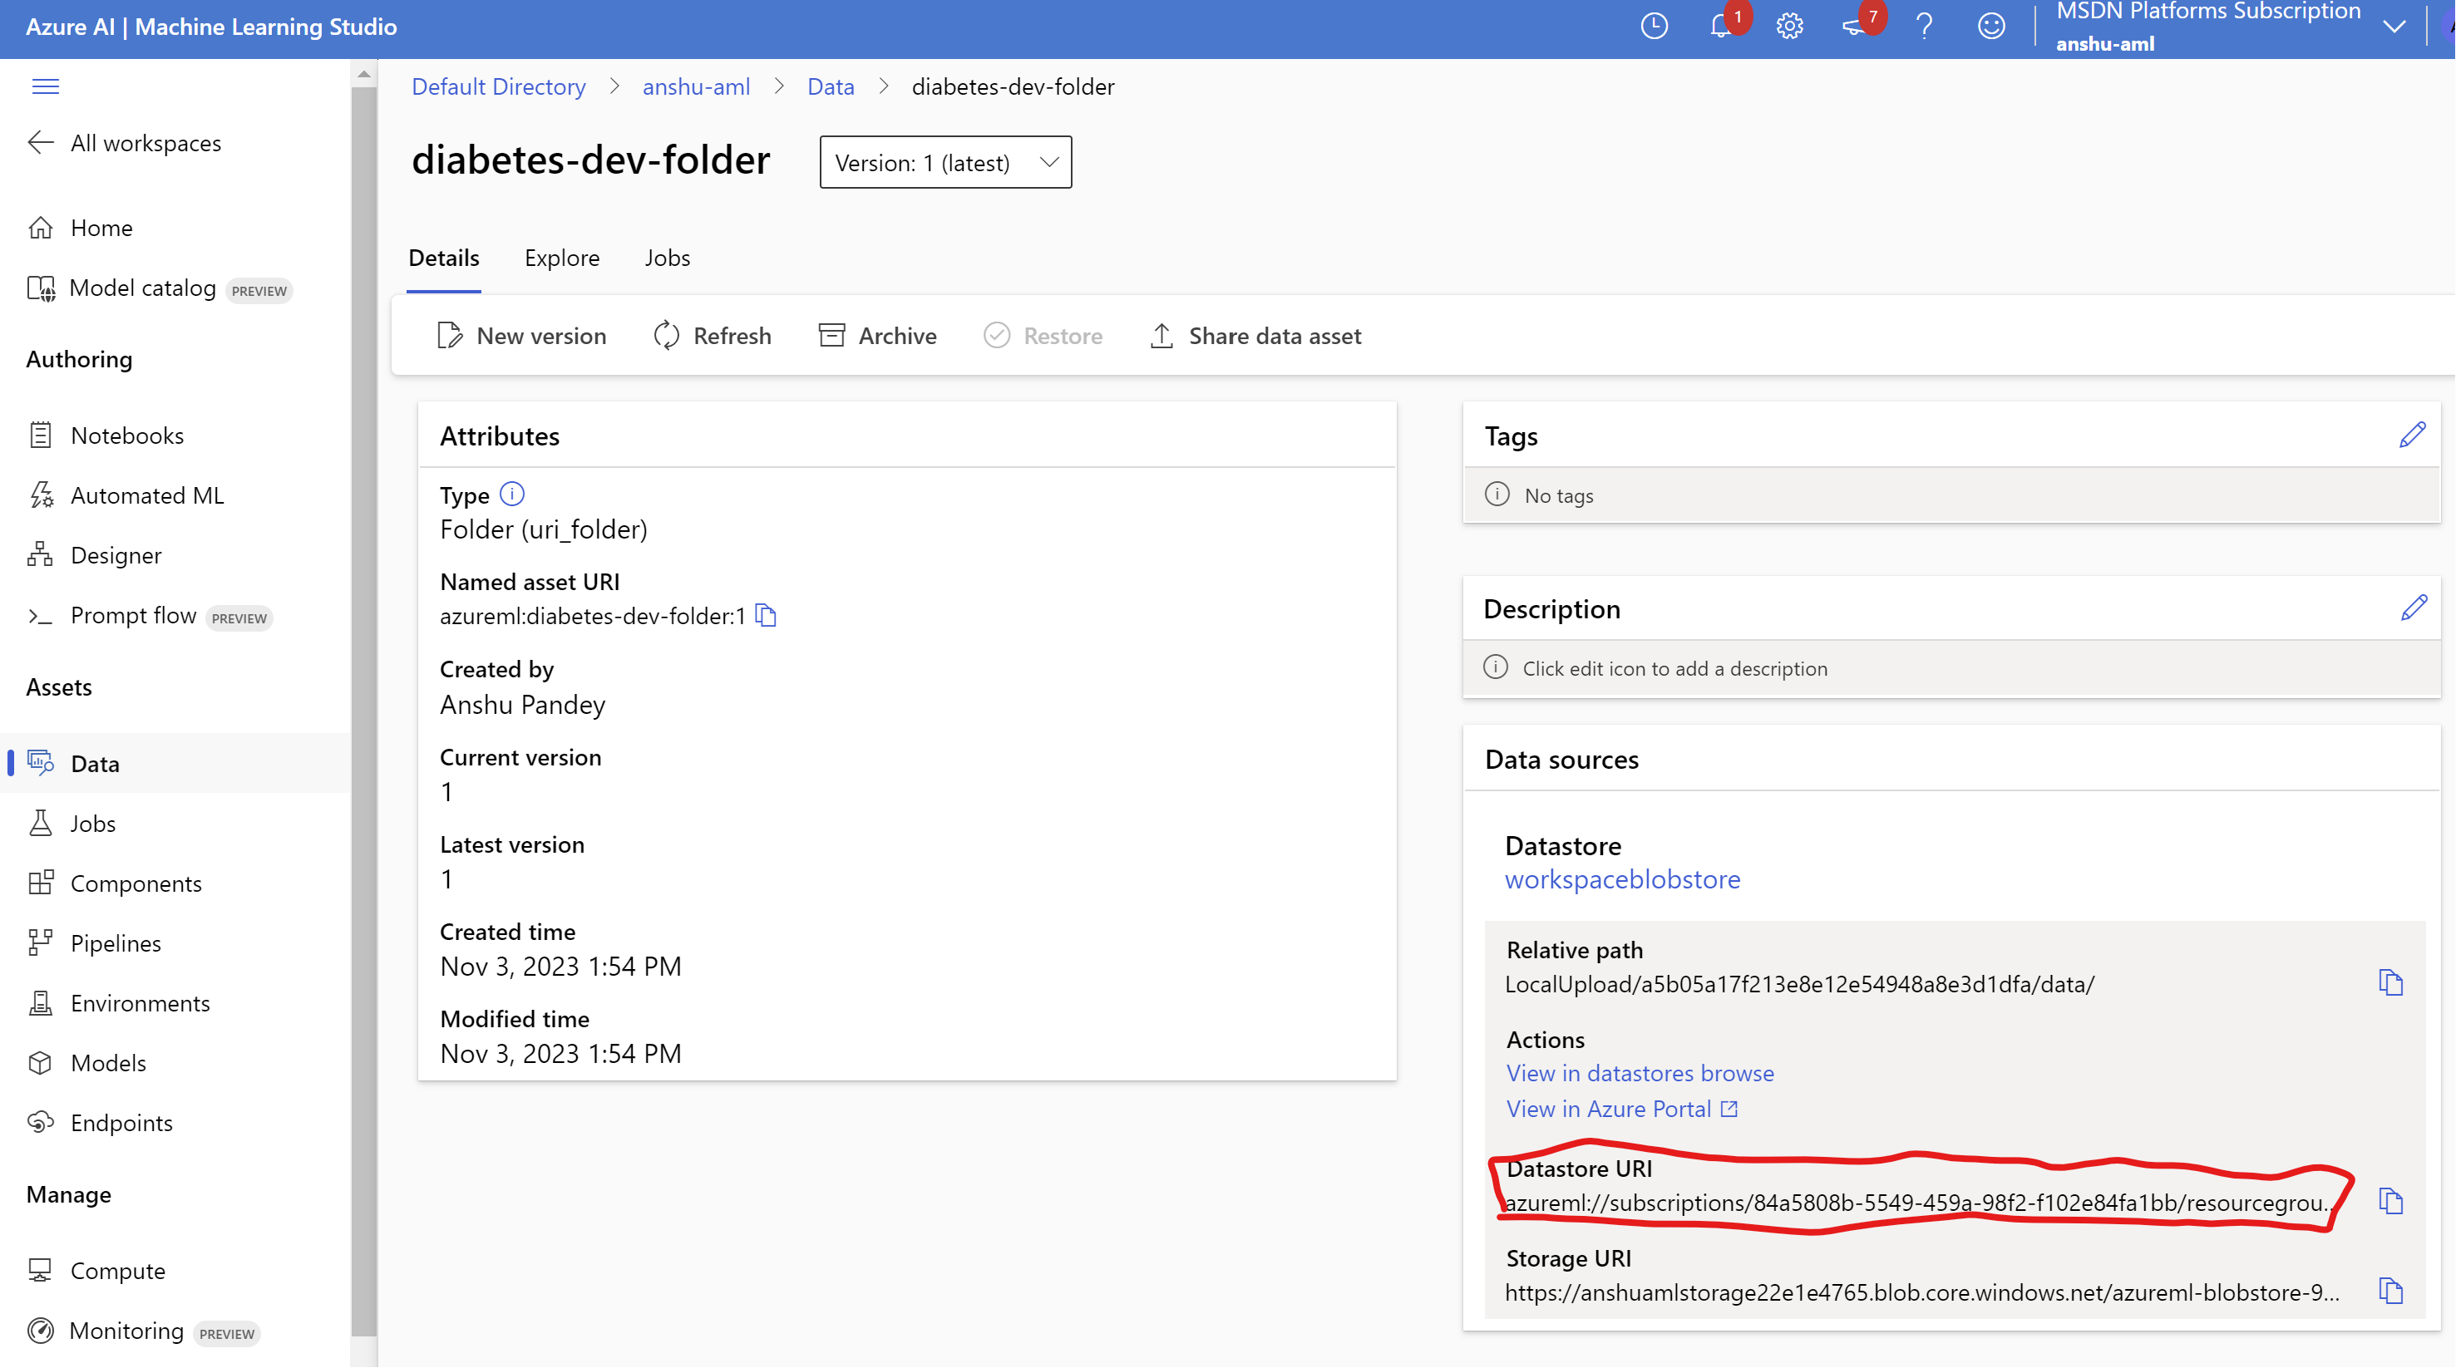
Get dataset URI
Complete the job.yml file to define the Azure Machine Learning job to run the train.py script, with the registered data asset as input. “Replace the Dataset URI in path option for training data”
Use the CLI (v2) to run the job.
azureml://subscriptions/84a5808b-5549-459a-98f2-f102e84fa1bb/resourcegroups/scb/workspaces/anshu-aml/datastores/workspaceblobstore/paths/LocalUpload/a5b05a17f213e8e12e54948a8e3d1dfa/data/

Slide 38
Running a job
Complete the job.yml file to define the Azure Machine Learning job to run the train.py script, with the registered data asset as input. “Replace the Dataset URI in path option for training data”
Use the CLI (v2) to run the job.
$schema: https://azuremlschemas.azureedge.net/latest/commandJob.schema.json
code: model
command: >-
python train.py
--training_data ${{inputs.training_data}}
--reg_rate ${{inputs.reg_rate}}
inputs:
training_data:
type: uri_folder
path: azureml://subscriptions/84a5808b-5549-459a-98f2-f102e84fa1bb/resourcegroups/SCB/workspaces/aml-\anshu/datastores/workspaceblobstore/paths/LocalUpload/386681db2f7cd59e8c96f5ee80b212db/data/
reg_rate: 0.09
environment: azureml:AzureML-sklearn-0.24-ubuntu18.04-py37-cpu@latest
compute: aml-compute
experiment_name: diabetes-mlops
description: A demo classification model
Run command:
az ml job create --file job.yml -–workspace-name aml-anshu -–resource-group scb --web

Slide 39
CI Pipeline Milestone 3
Objective:
Creating service principal for GitHub Repo
Testing AzureML job trigger on push to main branch

Slide 40
GitHub Actions
GitHub Actions is a continuous integration and continuous delivery (CI/CD) platform that allows you to automate your build, test, and deployment pipeline. You can create workflows that build and test every pull request to your repository, or deploy merged pull requests to production.
GitHub Actions goes beyond just DevOps and lets you run workflows when other events happen in your repository. For example, you can run a workflow to automatically add the appropriate labels whenever someone creates a new issue in your repository.
GitHub provides Linux, Windows, and macOS virtual machines to run your workflows, or you can host your own self-hosted runners in your own data center or cloud infrastructure.
Detailed Tutorial: https://docs.github.com/en/actions/guides

Slide 41
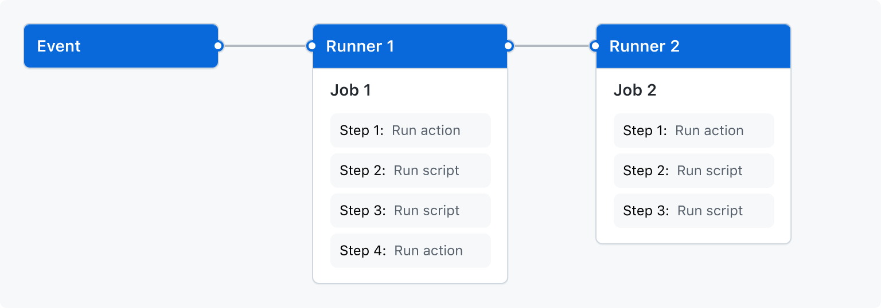
GitHub Actions
You can configure a GitHub Actions workflow to be triggered when an event occurs in your repository, such as a pull request being opened or an issue being created.
Your workflow contains one or more jobs which can run in sequential order or in parallel.
Each job will run inside its own virtual machine runner, or inside a container, and has one or more steps that either run a script that you define or run an action, which is a reusable extension that can simplify your workflow.

Slide 42
Trigger the Azure Machine Learning job with GitHub Actions
Steps
Create a service principal and use it to create a GitHub secret for authentication.
Run the Azure Machine Learning job with GitHub Actions.
note: GitHub is authenticated to use your Azure Machine Learning workspace with a service principal. The service principal is only allowed to submit jobs that use a compute cluster, not a compute instance.

Slide 43
Trigger the Azure Machine Learning job with GitHub Actions
In the .github/workflows folder, you’ll find the 02-manual-trigger.yml file. The file defines a GitHub Action which can be manually triggered. The workflow checks out the repo onto the runner, installs the Azure Machine Learning extension for the CLI (v2), and logs in to Azure using the AZURE_CREDENTIALS secret.
Create a service principal, using the Cloud Shell in the Azure portal, which has contributor access to your resource group.
Save the output, you’ll also need it for later challenges. Update the <service-principal-name> (should be unique), <subscription-id>, and <your-resource-group-name> before using the following command:
Code
az ad sp create-for-rbac --name "<service-principal-name>" --role contributor \
--scopes /subscriptions/<subscription-id>/resourceGroups/<your-resource-group-name> \
--sdk-auth
Create a GitHub secret in your repository. Name it AZURE_CREDENTIALS and copy and paste the output of the service principal to the Value field of the secret.

Slide 44
Creating service principal
az ad sp create-for-rbac --name "github-actions" --role contributor --scopes /subscriptions/84a5808b-5549-459a-98f2-f102e84fa1bb/resourceGroups/scb --sdk-auth
Template:
az ad sp create-for-rbac --name "<service-principal-name>" --role contributor \ --scopes /subscriptions/<subscription-id>/resourceGroups/<your-resource-group-name> \ --sdk-auth

Slide 45
GitHub Action secret format
{
"clientId": "your-client-id",
"clientSecret": "your-client-secret",
"subscriptionId": "your-subscription-id",
"tenantId": "your-tenant-id",
"activeDirectoryEndpointUrl": "https://login.microsoftonline.com",
"resourceManagerEndpointUrl": "https://management.azure.com/",
"activeDirectoryGraphResourceId": "https://graph.windows.net/",
"sqlManagementEndpointUrl": "https://management.core.windows.net:8443/",
"galleryEndpointUrl": "https://gallery.azure.com/",
"managementEndpointUrl": "https://management.core.windows.net/"
}

Slide 46
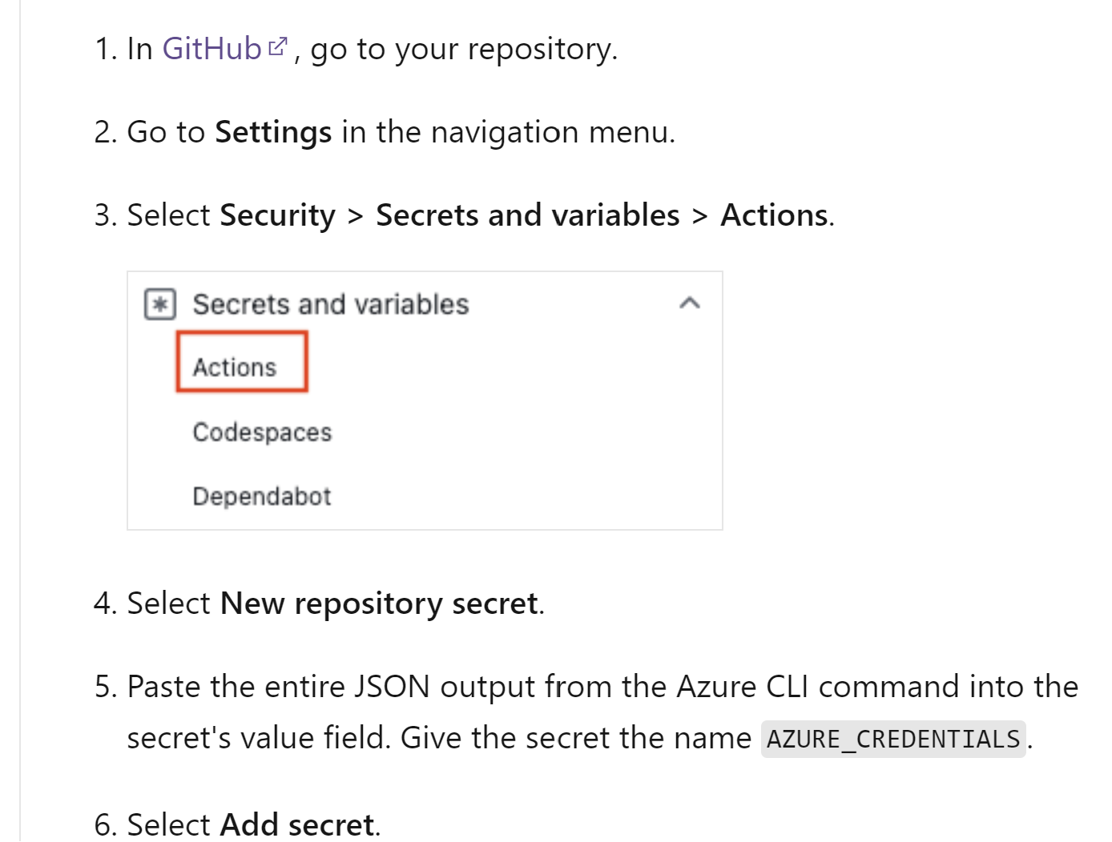
Client Secret

Slide 47
Prepare workflow:
Edit the 02-manual-trigger.yml workflow to trigger the Azure Machine Learning job.
Prepare job.yml, add details such as command for execution (last 2 lines), Push changes to github repo
name: Manually trigger an Azure Machine Learning job on:
workflow_dispatch: jobs:
train:
runs-on: ubuntu-latest
steps:
- name: Check out repo
uses: actions/checkout@main
- name: Install az ml extension
run: az extension add -n ml -y
- name: Azure login
uses: azure/login@v1
with:
creds: ${{secrets.AZURE_CREDENTIALS}}
- name: Run Azure ML Job
run: az ml job create --file src/job.yml --workspace-name anshu-aml --resource-group scb

Slide 48
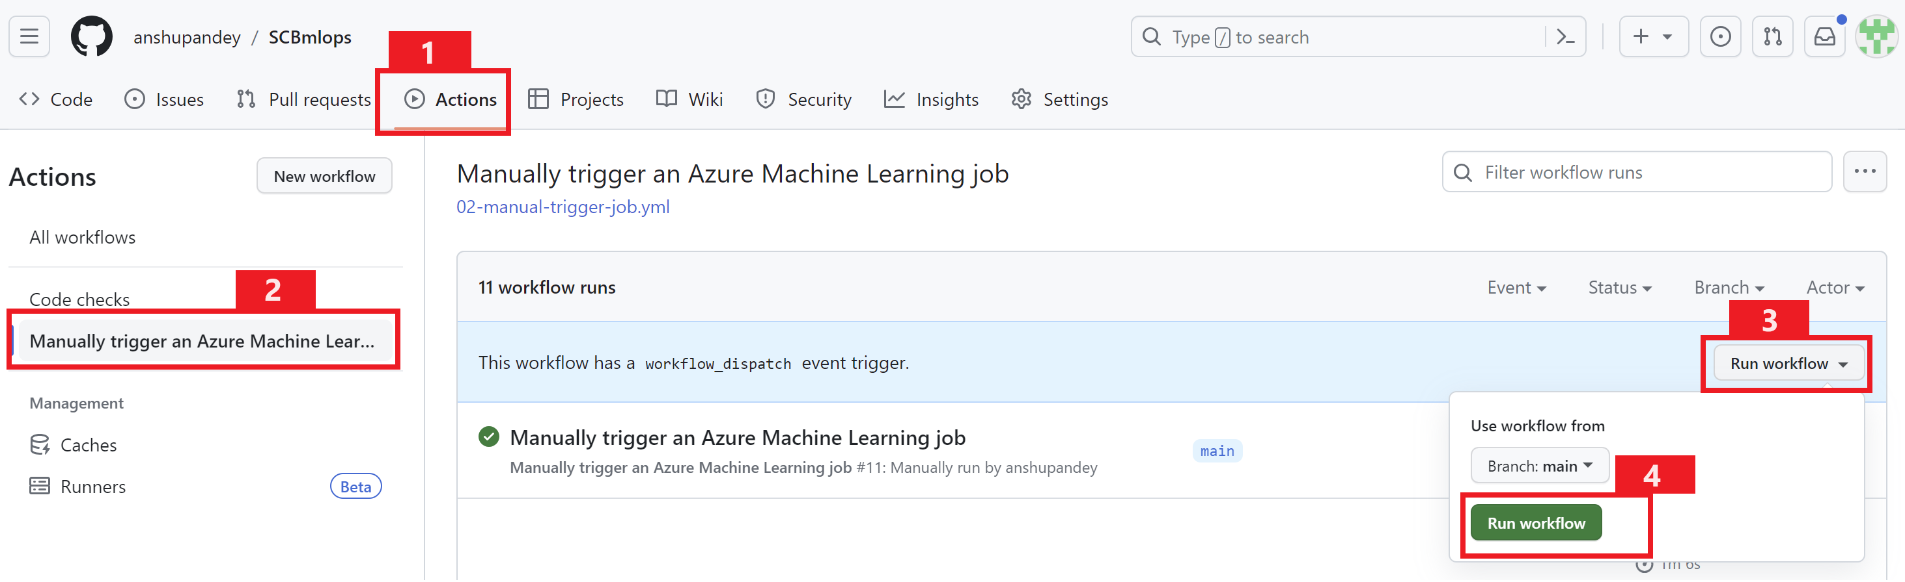
Trigger the Azure Machine Learning job with GitHub Actions
Navigate to GirHub repo and manually run the workflow to trigger the azure machine learning job. Check azure machine learning job execution over AML Studio. You can observe that the job is created by service principal.
More documentation: https://docs.github.com/en/actions/using-workflows/manually-running-a-workflow

Slide 49
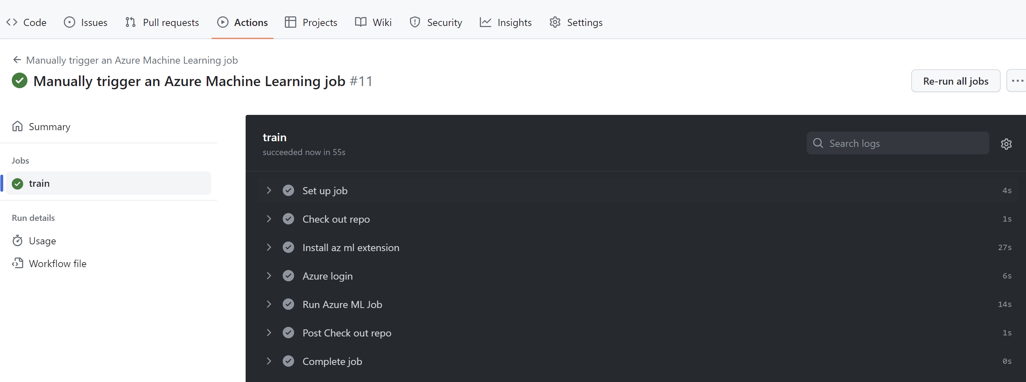
Trigger the Azure Machine Learning job with GitHub Actions
Validate the workflow run.
Also check azure machine learning job execution over AML Studio. You can observe that the job is created by service principal.

Slide 50
CI Pipeline Milestone 4
Objective:
Setting up feature branch, creating branch protection rule
Setting up testing and linting process flow with GitHub Actions
Building complete CI Pipeline

Slide 51
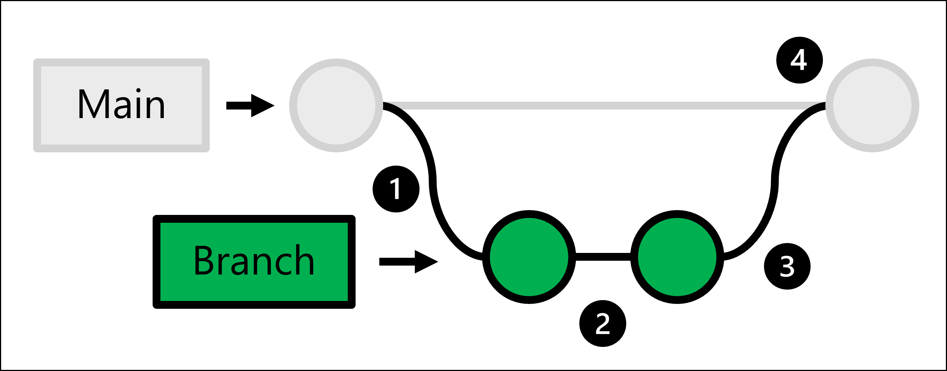
Trunk-based development
Triggering a workflow by pushing directly to the repo is not considered a best practice.
The production code is hosted in the main branch. Whenever someone wants to make a change:
You create a full copy of the production code by creating a branch.
In the branch you created, you make any changes and test them.
Once the changes in your branch are ready, you can ask for someone to review the changes.
If the changes are approved, you merge the branch you created with the main repo and the production code will be updated to reflect your changes.

Slide 52
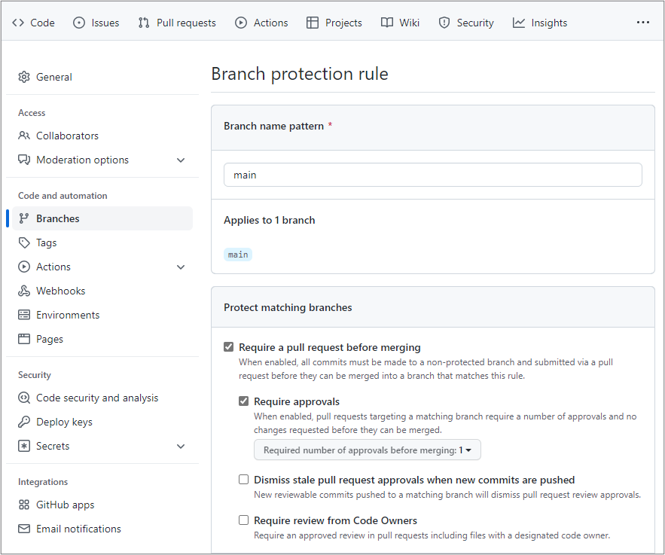
Create a branch protection rule
To protect your code, you want to block any direct pushes to the main branch. Blocking direct pushes means that no one will be allowed to directly push any code changes to the main branch. Instead, changes to the main branch can be made by merging pull requests.
To protect the main branch, enable a branch protection rule in GitHub:
Navigate to the Settings tab in your repo.
In the Settings tab, under Code and automation, select Branches.
Select Add rule.
Enter main under Branch name pattern.
Enable Require a pull request before merging and Require approvals.
Save your changes.

Slide 53
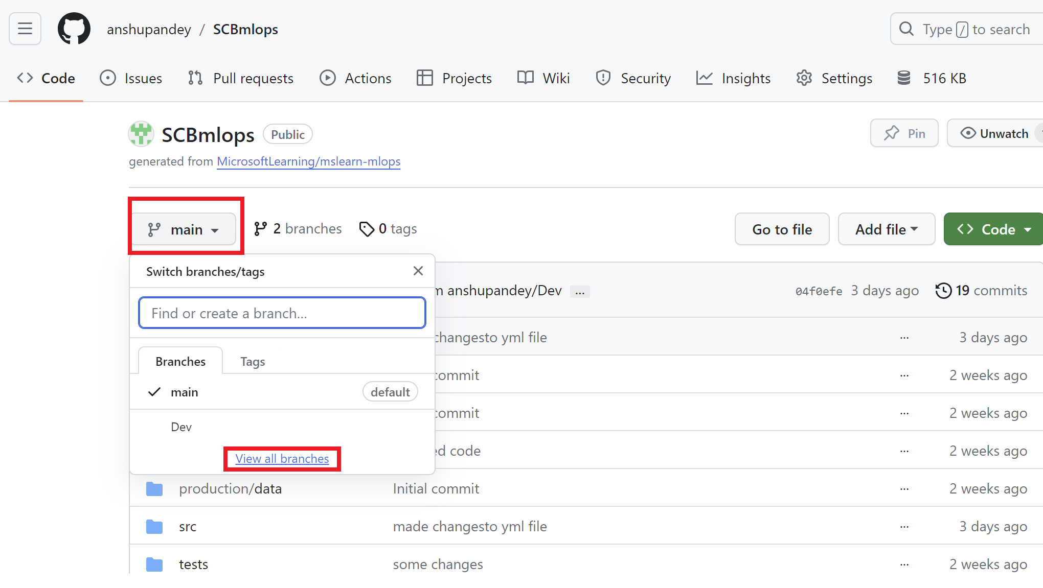
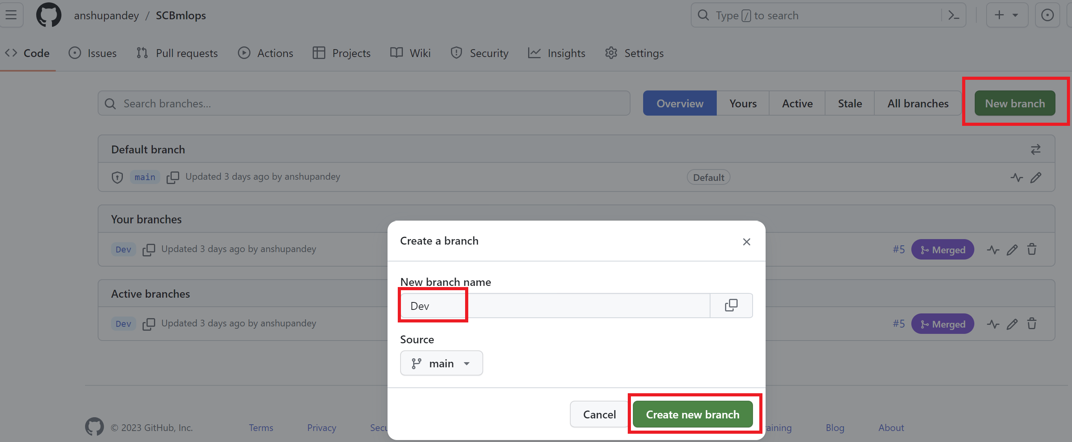
Create a branch to update the code.
Whenever you want to edit the code, you'll have to create a branch and work in there. Once you want to make your changes final, you can create a pull request to merge the feature branch with the main branch.
More reads:
https://learn.microsoft.com/en-us/training/modules/source-control-for-machine-learning-projects/3-work-azure-repos-github-repos
Clone the “Dev” branch locally in VS Code.

Slide 54
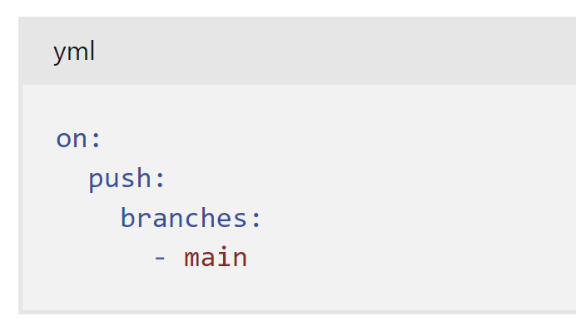
Trigger a GitHub Actions workflow
Finally, you may want to use the creation of pull requests as a trigger for GitHub Actions workflows. For example, whenever someone makes changes to the code, you'll want to run some code quality checks.
Only when the edited code has passed the quality checks and someone has verified the proposed changes, do you want to actually merge the pull request.
To trigger a GitHub Actions workflow, you can use on: [pull_request]. When you use this trigger, your workflow will run whenever the pull request is created.
If you want a workflow to run whenever a pull request is merged, you'll need to use another trigger. Merging a pull request is essentially a push to the main branch. So, to trigger a workflow to run when a pull request is merged, use the following trigger in the GitHub Actions workflow:

Slide 55
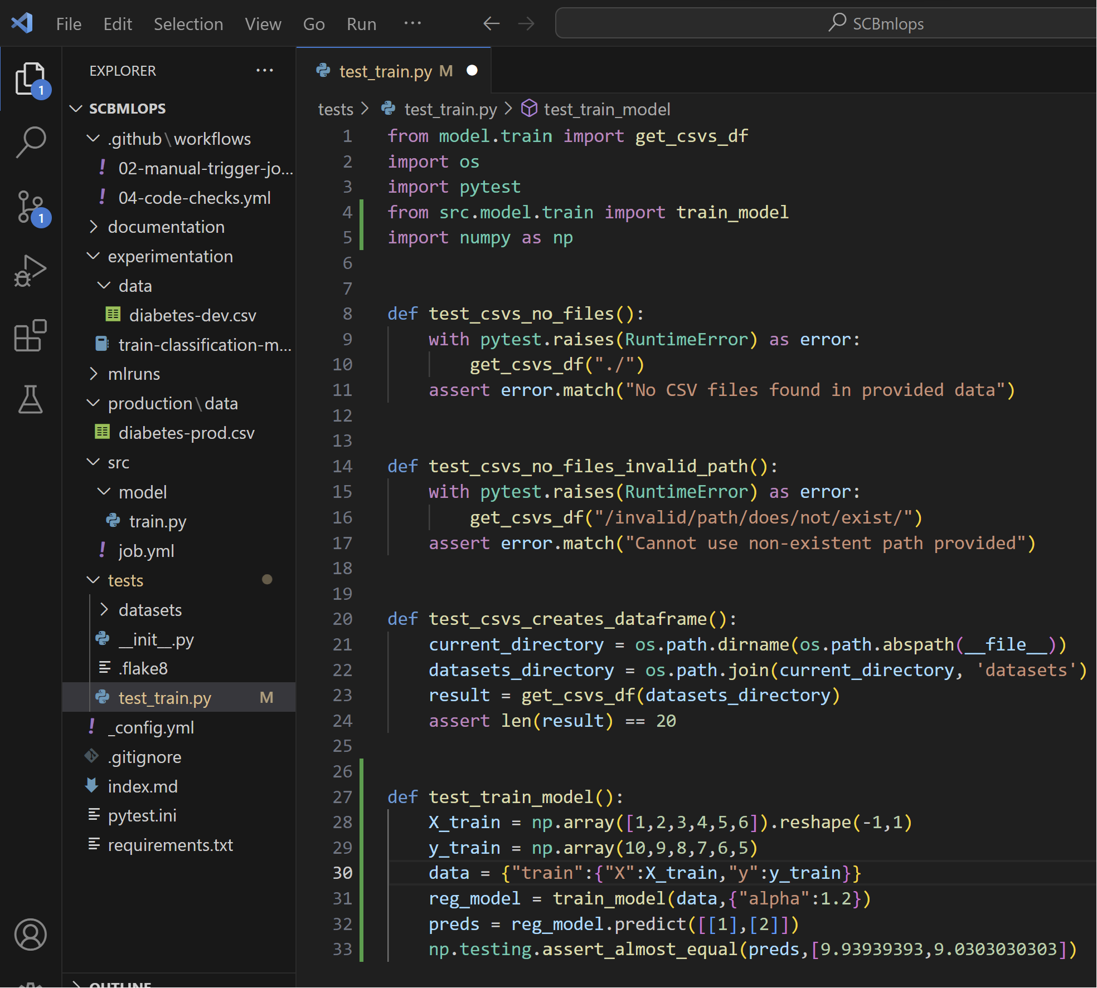
Unit Testing for dev code
To check whether the code works as expected, you can create unit tests. To easily test specific parts of your code, your scripts should contain functions. You can test functions in your scripts by creating test files. A popular tool to test Python code is Pytest.
Where linting verifies how you wrote the code, unit tests check how your code works. Units refer to the code you create. Unit testing is therefore also known as code testing.
As a best practice, your code should exist mostly out of functions. Whether you've created functions to prepare data, or to train a model. You can apply unit testing to, for example:
Check that column names are right.
Check the prediction level of model on new datasets.
Check the distribution of prediction levels.
When you work with Python, you can use Pytest and Numpy (which uses the Pytest framework) to test your code.
Install pytest
pip install pytest
Complete test_main.py

Slide 56
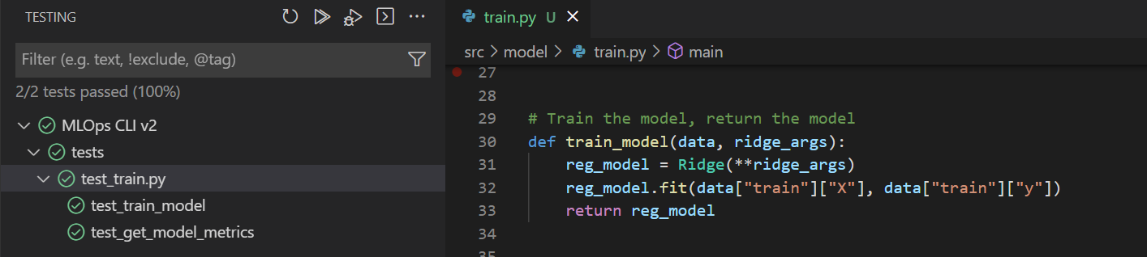
Unit Testing for dev code
from model.train import get_csvs_df
import os
import pytest
from src.model.train import train_model
import numpy as np
def test_csvs_no_files():
with pytest.raises(RuntimeError) as error:
get_csvs_df("./")
assert error.match("No CSV files found in provided data")
def test_csvs_no_files_invalid_path():
with pytest.raises(RuntimeError) as error:
get_csvs_df("/invalid/path/does/not/exist/")
assert error.match("Cannot use non-existent path provided")
def test_csvs_creates_dataframe():
current_directory = os.path.dirname(os.path.abspath(__file__))
datasets_directory = os.path.join(current_directory, 'datasets')
result = get_csvs_df(datasets_directory)
assert len(result) == 20
def test_train_model():
X_train = np.array([1,2,3,4,5,6]).reshape(-1,1)
y_train = np.array(10,9,8,7,6,5)
data = {"train":{"X":X_train,"y":y_train}}
reg_model = train_model(data,{"alpha":1.2})
preds = reg_model.predict([[1],[2]])
np.testing.assert_almost_equal(preds,[9.93939393,9.0303030303])
To test your code in Visual Studio Code using the UI:
Install all necessary libraries to run the training script.
Ensure pytest is installed and enabled within Visual Studio Code.
Install the Python extension for Visual Studio Code.
Select the train.py script you want to test.
Select the Testing tab from the left menu.
Configure Python testing by selecting pytest and setting the test directory to your tests/ folder.
Run all tests by selecting the play button and review the results.
https://learn.microsoft.com/en-us/training/modules/source-control-for-machine-learning-projects/5-verify-your-code-locally

Slide 57
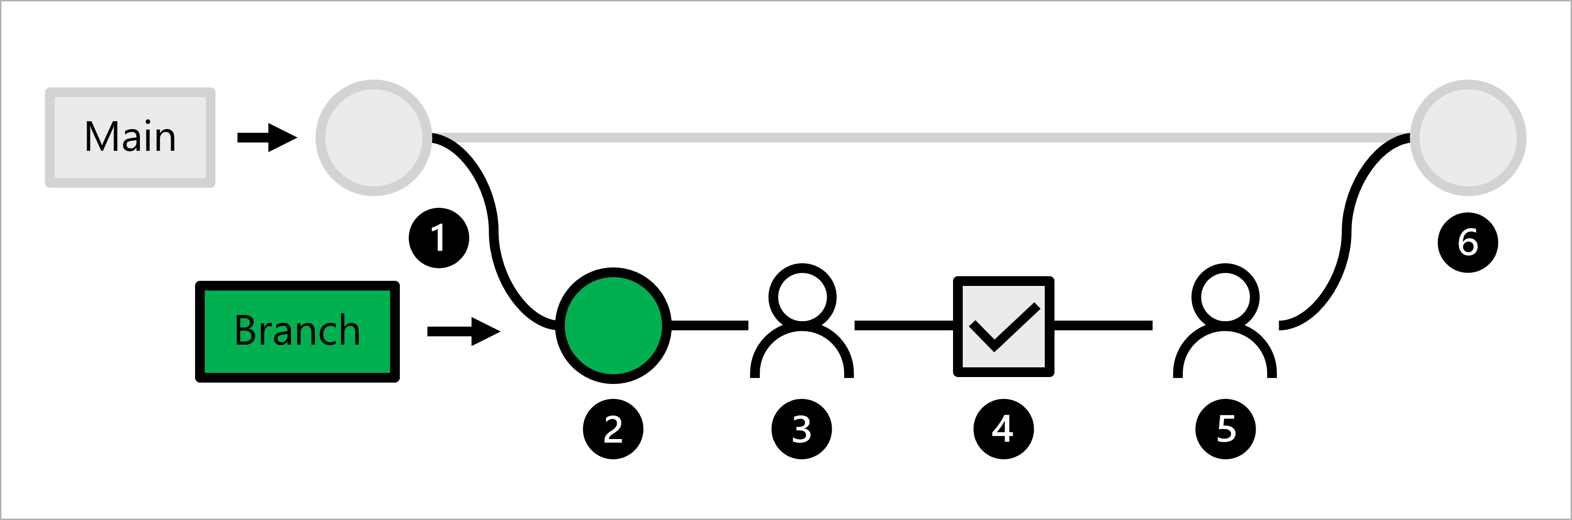
Linting and testing
The production code is hosted in the main branch.
A data scientist creates a feature branch for model development.
The data scientist creates a pull request to propose to push changes to the main branch.
When a pull request is created, a GitHub Actions workflow is triggered to verify the code.
When the code passes linting and unit testing, the lead data scientist needs to approve the proposed changes.
After the lead data scientist approves the changes, the pull request is merged, and the main branch is updated accordingly.
As a machine learning engineer, you'll need to create a GitHub Actions workflow that verifies the code by running a linter and unit tests whenever a pull request is created.

Slide 58
Verify your code locally
Whenever you change any code in your machine learning project, you want to verify the code and model quality.
During continuous integration, you create and verify assets for your application. As a data scientist, you'll probably focus on creating scripts used for data preparation and model training. The machine learning engineer uses the scripts later in pipelines to automate these processes.
To verify your scripts, there are two common tasks:
Linting: Check for programmatic or stylistic errors in Python or R scripts.
Unit testing: Check the performance of the content of the scripts.
https://learn.microsoft.com/en-us/training/modules/source-control-for-machine-learning-projects/5-verify-your-code-locally

Slide 59
Modify the workflow and test
Modify the workflow to trigger it when there is push to main branch.
Make changes to code, in the dev branch, push to dev branch
Create a pull request to merge the code to the main branch
Merge the pull request, merge to main branch is equivalent to push to main branch, it should automatically trigger the workflow to execute the training processing.

Slide 60
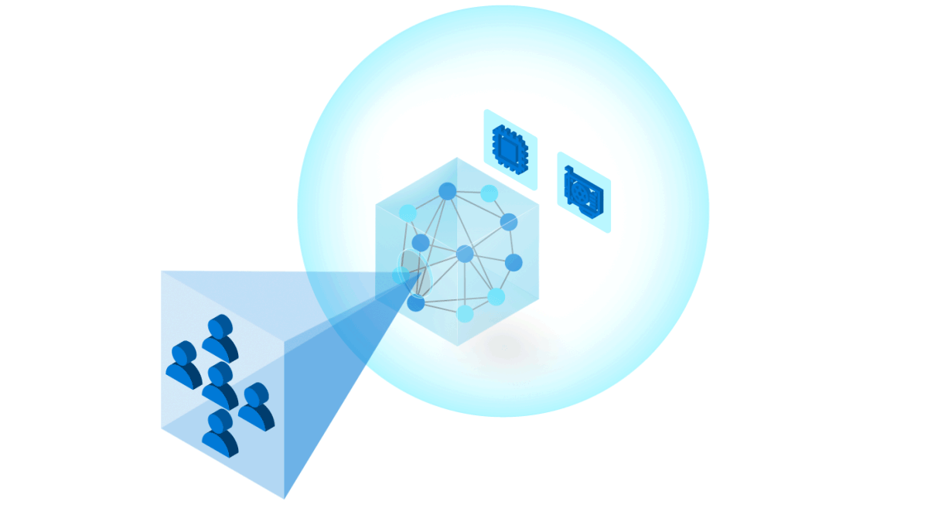
Continuous Deployment

Slide 61
Deployment config
$schema: https://azuremlschemas.azureedge.net/latest/managedOnlineDeployment.schema.json
name: mlflow-deployment
endpoint_name: churn-endpoint
model:
name: mlflow-sklearn-model
version: 1
local_path: model
model_format: mlflow
instance_type: Standard_F2s_v2
instance_count: 1

Slide 62
Deploy model with endpoint
az ml online-endpoint create --name diabetes-mlflow -f ./mslearn-aml-cli/Allfiles/Labs/05/mlflow-endpoint/create-endpoint.yml
az ml online-deployment create --name mlflow-deployment --endpoint diabetes-mlflow -f ./mslearn-aml-cli/Allfiles/Labs/05/mlflow-endpoint/mlflow-deployment.yaml --all-traffic
az ml online-endpoint update --name churn-endpoint --traffic "blue=0 green=100“
az ml online-endpoint delete --name churn-endpoint --yes --no-wait

Slide 63
Resources
https://learn.microsoft.com/en-in/training/paths/build-first-machine-operations-workflow/
https://microsoftlearning.github.io/mslearn-mlops/
https://learn.microsoft.com/en-us/training/modules/deploy-azure-machine-learning-model-managed-endpoint-cli-v2/
https://learn.microsoft.com/en-us/azure/machine-learning/how-to-deploy-online-endpoints?view=azureml-api-2&tabs=azure-cli#understand-the-scoring-script

Slide 64



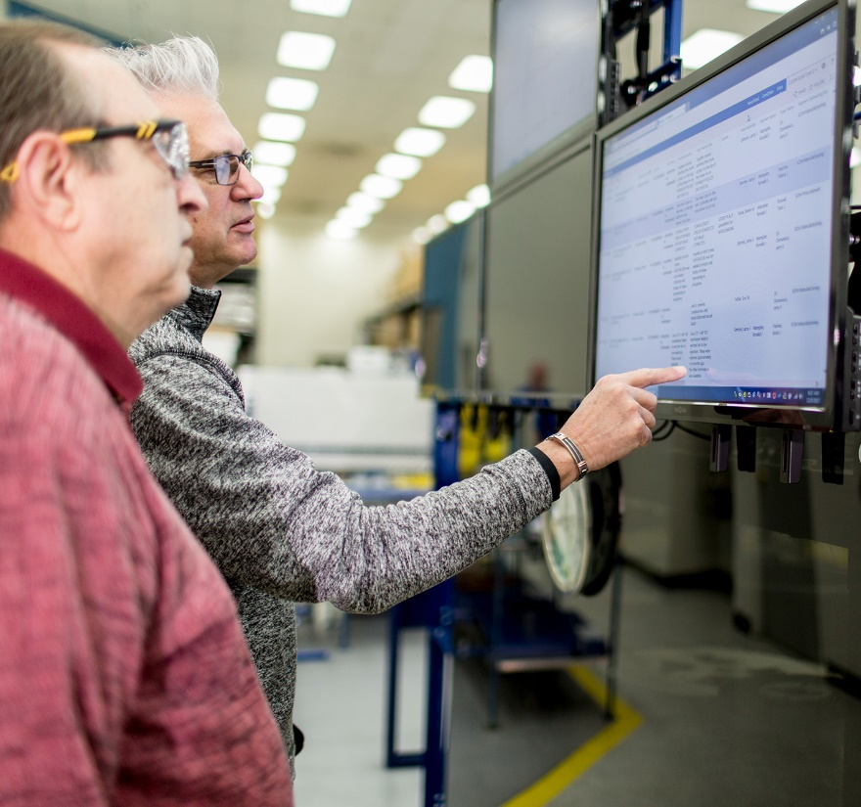









Lesson
Introduction to Model Interpretability
Data
Cloud
AI

Slide 65
Model Interpretability in Azure Machine Learning
Statistical explanation of feature importance
Quantifies the influence of each feature on prediction
Important to identify bias or unintended correlation in the model
Based on the Open Source Interpret-Community package
Includes explainers based on common model interpretation algorithms like:
Shapely Additive Explanations (SHAP)
Local Interpretable Model-Agnostic Explanations (LIME)

Slide 66
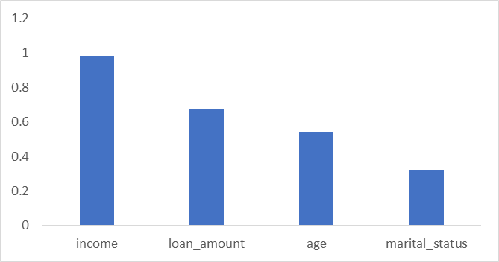
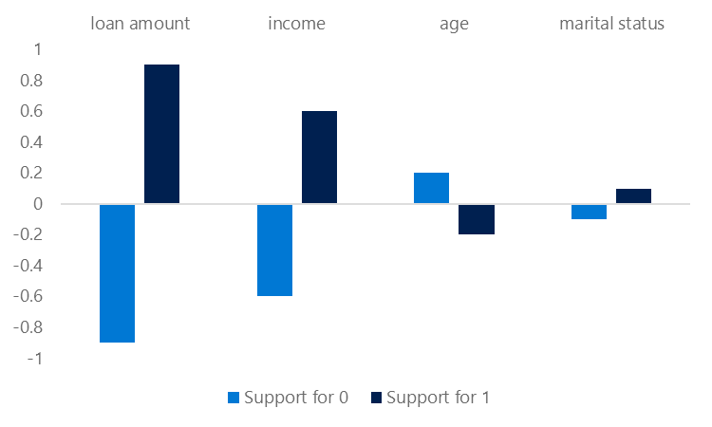
Global and Local Feature Importance
Global Feature Importance
Overall feature importance for all test data
Indicates ther relative influence of each feature on the predicted label
Local Feature Importance
Feature importance for an individual prediction
In classification, this shows the relative support for each possible class per feature

Slide 67
Automated Machine Learning Explanations
Enable model_explanability parameter
View explanations:
Azure Machine Learning studio
RunDetails widget in Jupyter
SDK ExplanationClient class
automl_config = AutoMLConfig(name='Automated ML Experiment',
...,
model_explanability=True)
best_run, fitted_model = automl_run.get_output()
client = ExplanationClient.from_run(best_run)
explanation = client.download_model_explanation()
feature_importances = explanation.get_feature_importance_dict()

Slide 68
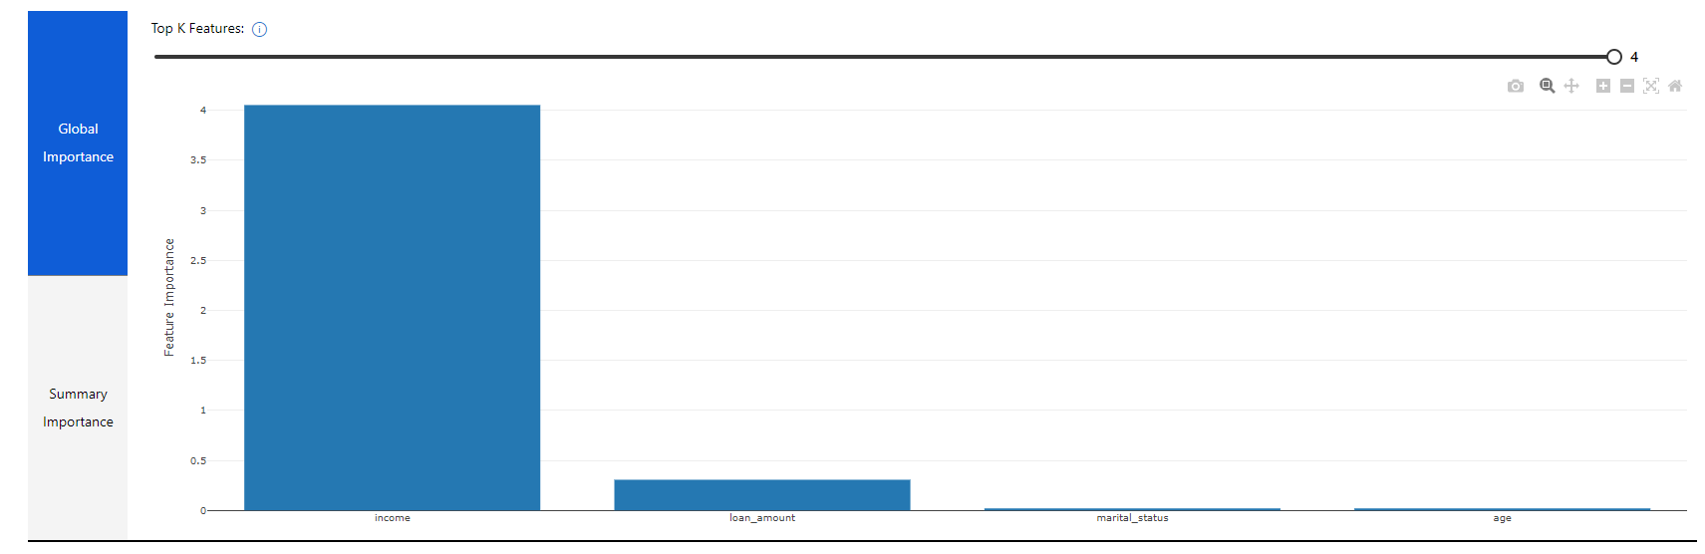
Visualizing Model Explanations
View the Explanations tab for the run in Azure Machine Learning studio

Slide 69
Lesson
Using Model Explainers
Data
Cloud
AI

Slide 70
Local Model Interpretation
Use the azureml-interpret package
Create an explainer:
MimicExplainer – global surrogate model that approximates your model
TabularExplainer – Invokes direct SHAP explainer based on model architecture
PFIExplainer – Permutation Feature Importance based on feature shuffling
Get global or local feature explanations
from interpret.ext.blackbox import TabularExplainer
tab_explainer = TabularExplainer(model, X_train, features=features, classes=labels)
global_explanation = tab_explainer.explain_global(X_train)

Slide 71
Adding Interpretability to Training Experiments
In the training script, import the ExplanationClient class
Generate explanations and upload them to the run
Use ExplanationClient to download explanations
explain_client = ExplanationClient.from_run(run)
explainer = MimicExplainer(model, X_train, LinearExplainableModel,
features=features, classes=labels)
explanation = explainer.explain_global(X_test)
explain_client.upload_model_explanation(explanation, comment='Model Explanation')
from azureml.contrib.interpret.explanation.explanation_client import ExplanationClient
client = ExplanationClient.from_run_id(workspace=ws,
experiment_name=experiment.experiment_name,
run_id=run.id)
explanation = client.download_model_explanation()

Slide 72
Interpretability During Inferencing
Register a lightweight scoring explainer with the model
Use the model and the explainer in the service scoring script
Deploy a service with the model and explainer
scoring_explainer = KernelScoringExplainer(explainer)
save(scoring_explainer, directory='dir', exist_ok=True)
Model.register(ws, model_name='model', model_path='dir/model.pkl')
Model.register(ws, model_name='explainer', model_path='dir/scoring_explainer.pkl')
def run(raw_data):
data = json.loads(raw_data)['data']
predictions = model.predict(data)
local_importance_values = explainer.explain(data)
return {"predictions":predictions.tolist()), "importance":local_importance_values}
service = Model.deploy(ws, 'classify_svc', [model, explainer], inf_config, dep_config)

Slide 73
Model fairness
When we consider the concept of fairness concerning predictions made by machine learning models, it helps to be clear about what we mean by "fair".
For example, suppose a classification model is used to predict the probability of successful loan repayment and therefore influences whether or not the loan is approved. The model will likely be trained using features that reflect the characteristics of the applicant, such as:
Age
Employment status
Income
Savings
Current debt

Slide 74
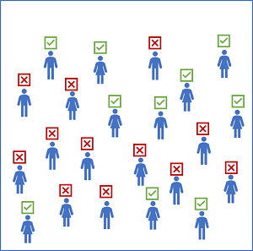
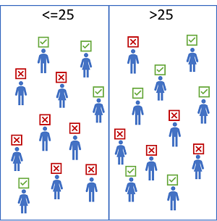
Example

Slide 75
Potential causes of disparity
Data imbalance. Some groups may be overrepresented in the training data, or the data may be skewed so that cases within a specific group aren't representative of the overall population.
Indirect correlation. The sensitive feature itself may not be predictive of the label, but there may be a hidden correlation between the sensitive feature and some other feature that influences the prediction. For example, there's likely a correlation between age and credit history, and there's likely a correlation between credit history and loan defaults. If the credit history feature is not included in the training data, the training algorithm may assign a predictive weight to age without accounting for credit history, which might make a difference to loan repayment probability.
Societal biases. Subconscious biases in the data collection, preparation, or modeling process may have influenced feature selection or other aspects of model design.

Slide 76
Mitigating Bias
Optimizing for fairness in a machine learning model is a sociotechnical challenge. In other words, it's not always something you can achieve purely by applying technical corrections to a training algorithm. However, there are some strategies you can adopt to mitigate bias, including:
Balance training and validation data. You can apply over-sampling or under-sampling techniques to balance data and use stratified splitting algorithms to maintain representative proportions for training and validation.
Perform extensive feature selection and engineering analysis. Make sure you fully explore the interconnected correlations in your data to try to differentiate features that are directly predictive from features that encapsulate more complex, nuanced relationships. You can use the model interpretability support in Azure Machine Learning to understand how individual features influence predictions.
Evaluate models for disparity based on significant features. You can't easily address the bias in a model if you can't quantify it.
Trade-off overall predictive performance for the lower disparity in predictive performance between sensitive feature groups. A model that is 99.5% accurate with comparable performance across all groups is often more desirable than a model that is 99.9% accurate but discriminates against a particular subset of cases.

Slide 77
Mitigation algorithms and parity constraints
The mitigation support in Fairlearn is based on the use of algorithms to create alternative models that apply parity constraints to produce comparable metrics across sensitive feature groups. Fairlearn supports the following mitigation techniques.
Technique | Description | Model type support
Exponentiated Gradient | A reduction technique that applies a cost-minimization approach to learning the optimal trade-off of overall predictive performance and fairness disparity | Binary classification and regression
Grid Search | A simplified version of the Exponentiated Gradient algorithm that works efficiently with small numbers of constraints | Binary classification and regression
Threshold Optimizer | A post-processing technique that applies a constraint to an existing classifier, transforming the prediction as appropriate | Binary classification

